Slide 1

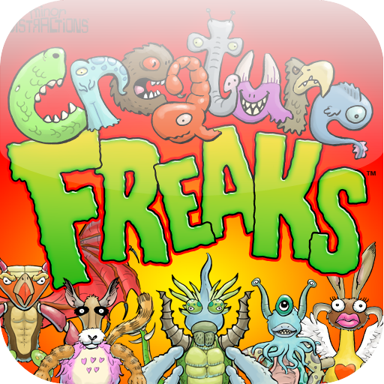
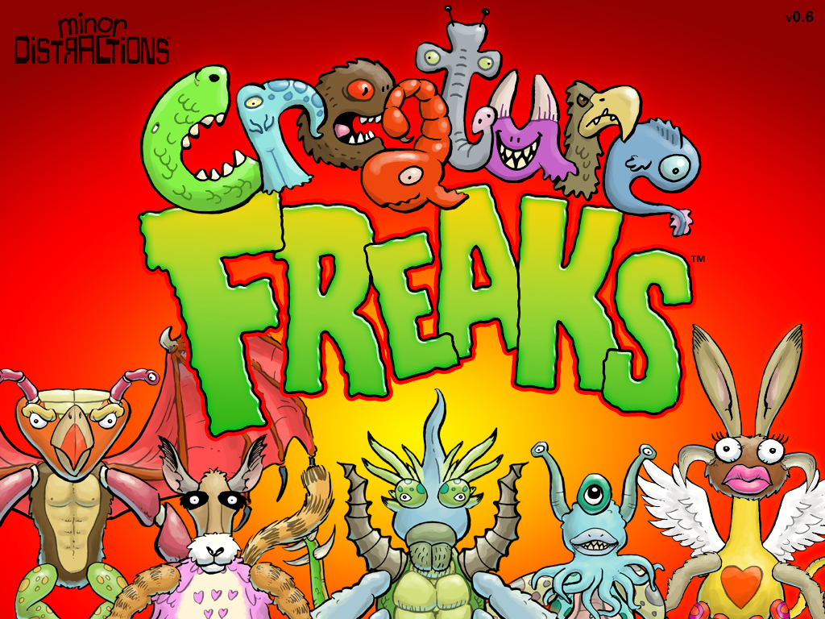
Creature Freaks

Slide 2
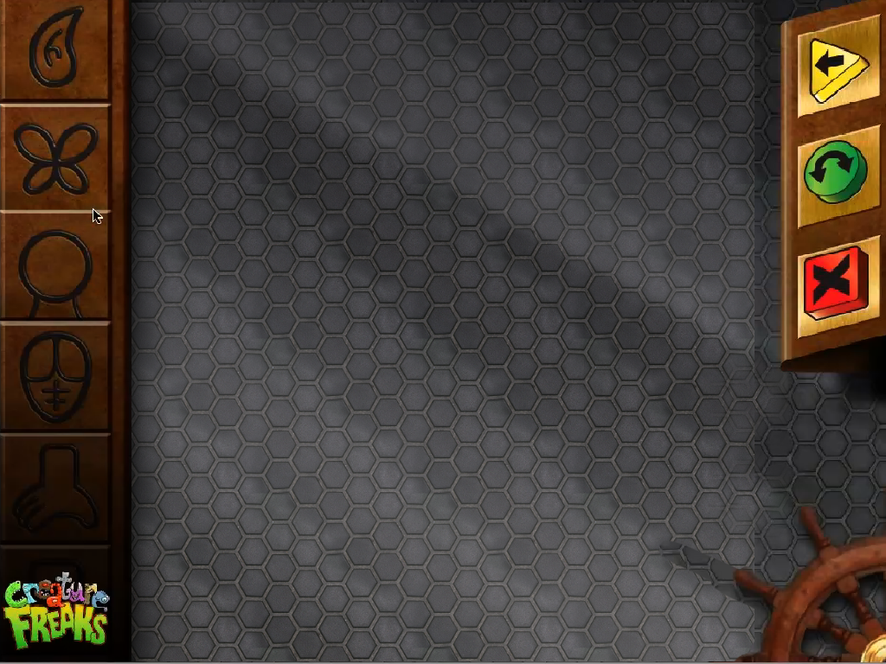
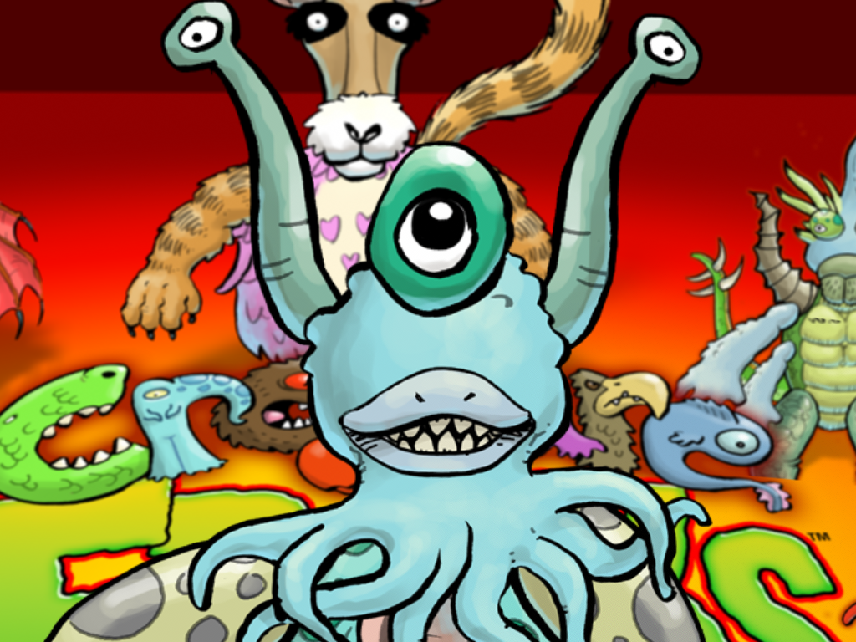
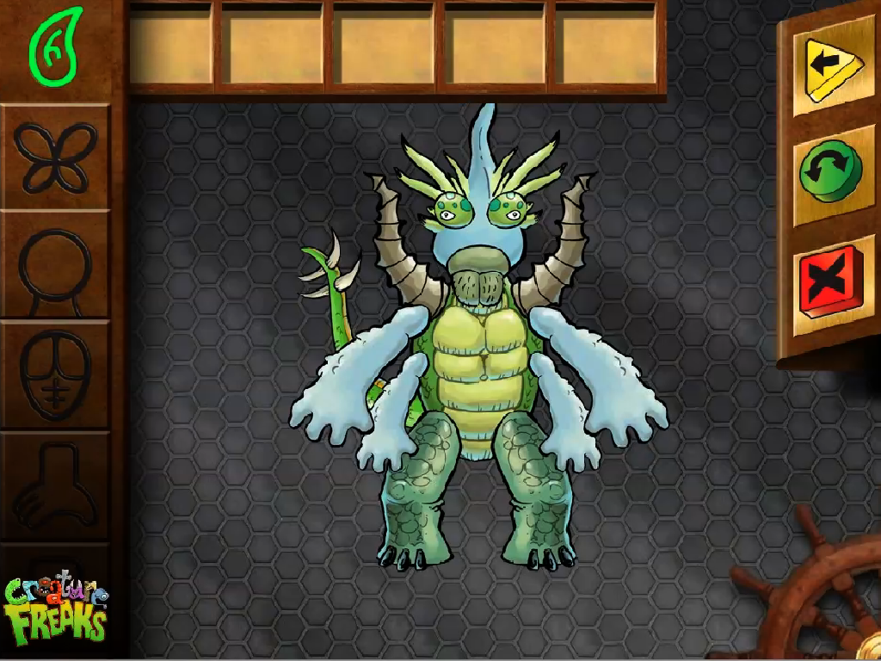
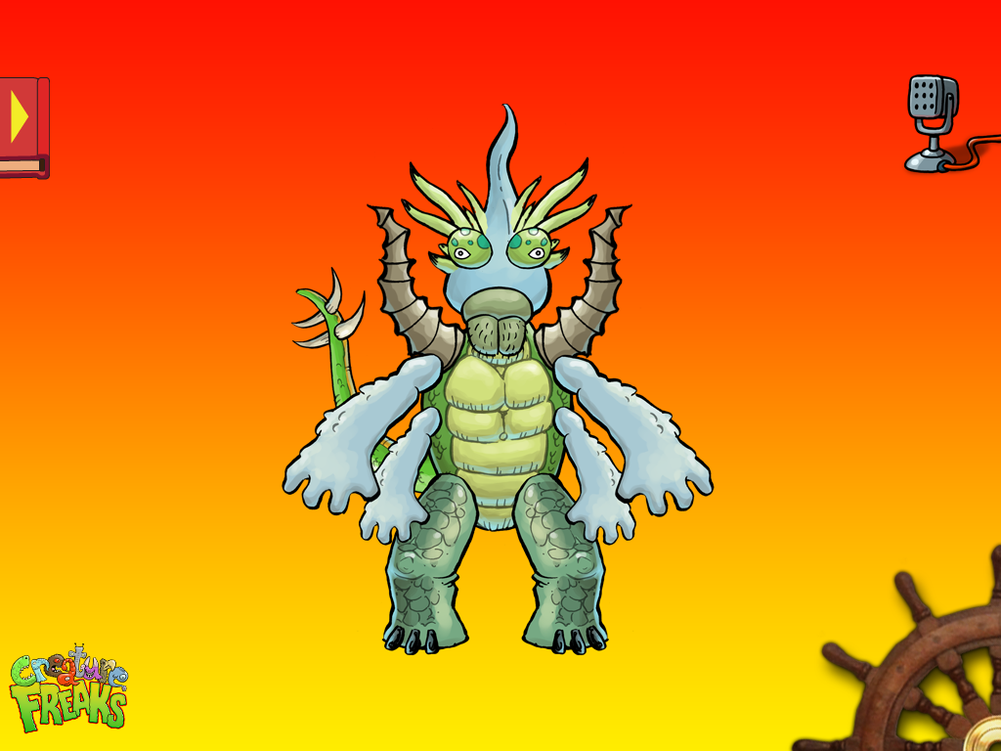
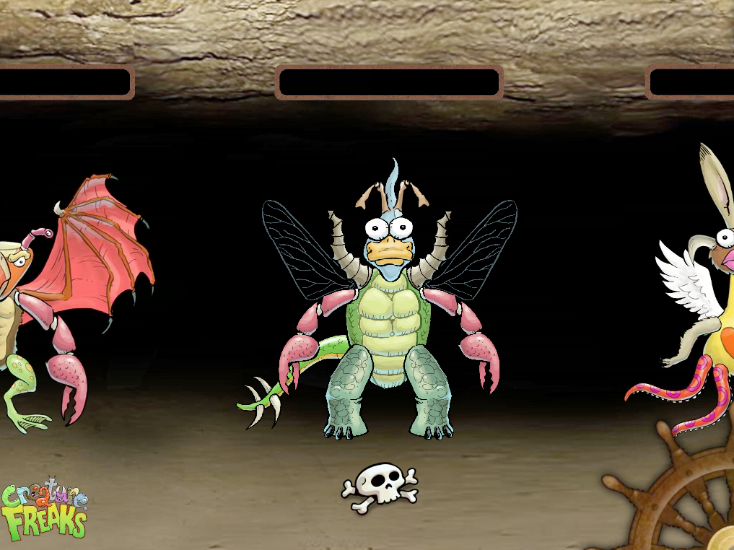
New User Flow
First Time User: launches to Edit Screen.
Returning User:reopens app to saved state from last visit
launch animation - 17 frames
- optional

Slide 3
General Navigation
1. Users edit creatures in the Build Screen. Initially, this will be blank. If they purchase the Full Version, they can create unlimited creatures; otherwise, they can only edit their one Creature.
2. Swiping the wheel to the right takes them to the Play screen, where they can interact with their creature. (Swiping right again takes them to the Dungeon “Manage” screen.)
3. Turning the wheel left moves them to the Dungeon "Manage" screen, where they can delete creatures, name creatures (optional) or, if they’ve purchased the Full Version, Make a New Creature.
a. Swiping right with 1 Creature returns them to the “Edit Creature” screen, where they can further edit their creature.
b. Swiping left takes them to the “Play” screen, where their first creature becomes animated and interactive.
c. If they Delete their Creature, they are automatically taken out of the Dungeon screen and back into the Build screen, cuz it probably doesn’t make sense to hang around an empty dungeon.

Slide 4
First time launch animation
17 frames
FOR FUTURE RELEASE
launch animation -
can we do this on first launch?
I'll make the last frame of the animation match the splash screen -
optional Phase 2: other launch animations that come up every 10 openings or so to advertise our other parts packs.

Slide 5
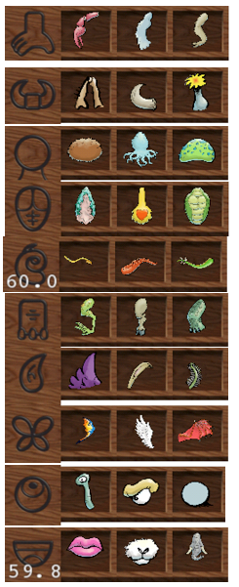

Build / Create
Auto Animate: drawers on idle --after <10> seconds, a drawer will automatically pop open, maybe a part will highlight.
This background does not change
Freemium Plus model-
Display 6 parts for each category (10 total)
1,2,3 are free, 4,5,6 plus (require in-app purchase.
Parts read right to left 6,5,4,3,2,1
Available parts:
- Head
- Horns/Hats/Hair
- Eyes
- Nose & Mouth
- Arms & Hands
- Legs & Feet
- Tail
3 Dimmed part packs:
-Horns
-Tail
-Wings
Note: All drawers display 6 parts; first 3 are all dimmed

Slide 6
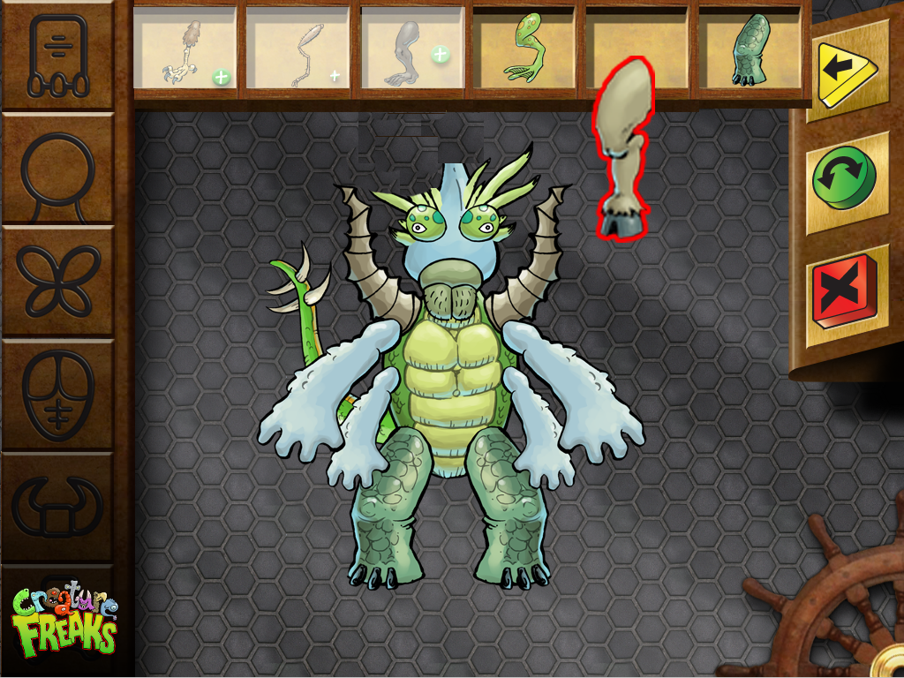
Build / Create -Upgrade
Use "Plus" buy button to display message about more part packs available for purchase.

Slide 7
"About" Creature Freaks page
When pressing the "Creature Freaks" button on any screen, users will see this text (page design TBD):
Welcome to Creature Freaks, a madcap monster mashup. Create and share your own fun, freaky creatures!
Over <1,000> combinations of freaky parts
Poke and prod your creature for giggly fun
Incorporate your own pictures to interact with your creations
Print coloring pages for offscreen creativity (optional/Phase 2)
Press Buy/More Parts to get storage for more creatures and additional parts.
[LINK:] Buy More Parts [LINK:] Contact Us

Slide 8

Send Back
Sends Back one layer
(back one layer)
(thinking less complexity is best for our target age group. e.g. not send back and bring forward, or send all the way to the back)

Slide 9

Flip
horizontal flip

Slide 10
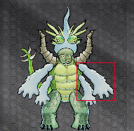
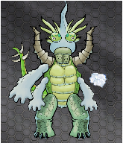
Delete
Press Delete
Image: A puff of cloud
Sound:
1-whoosh
2-If no part is selected, a
‘bonk’ sound plays

Slide 11
Dungeon
To Delete Creature: Pressing Skull triggers auto-animation that wipes out creature.
(phase 2/optional) To Name Creature: Pressing empty sign above creature brings up keyboard.
(phase 2/optional) To Save Multiple Creatures: Press PLUS-Sign in all labels but 'main'
sounds:
Delete Creature

Slide 12
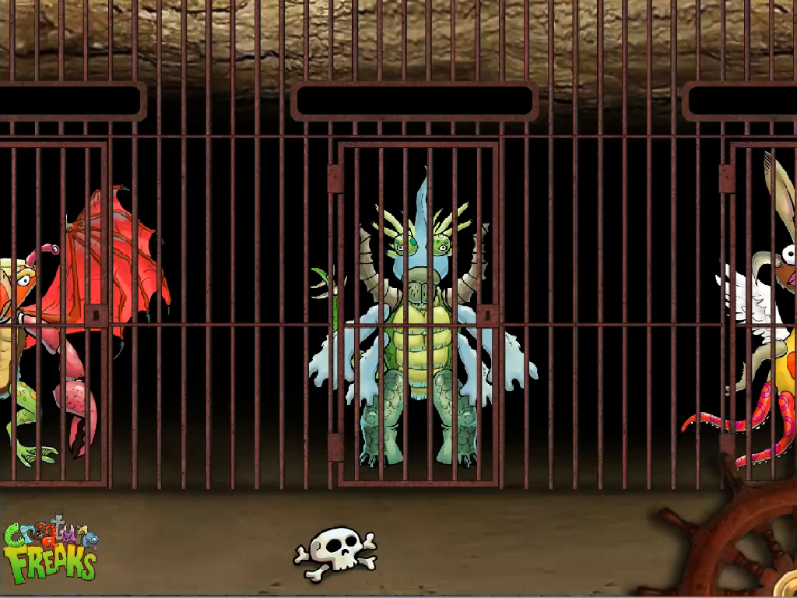
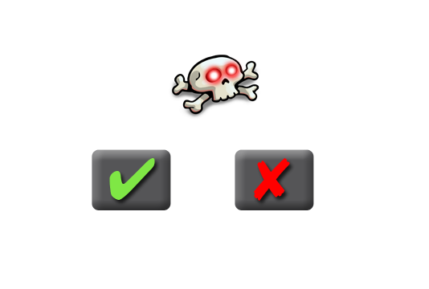
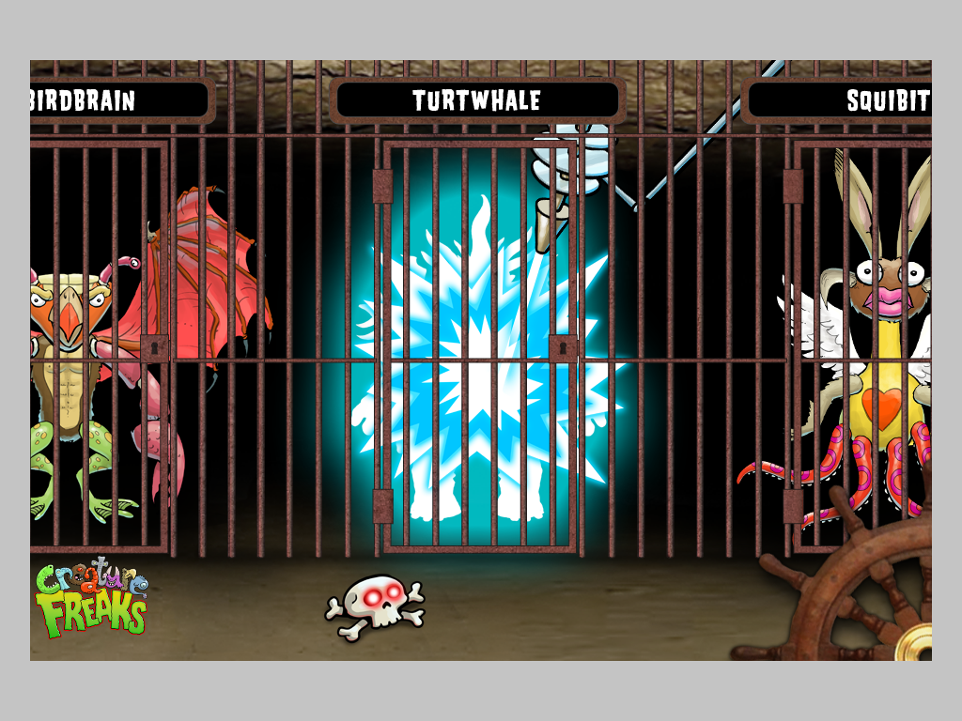




Dungeon-delete
sounds:
Delete Creature
Touch:
Skull -
x/checkmark confirm overlay comes up
-delete animation comes in behind bars. Deletes center creature
-1 of 3 random delete images
See Quicktime movie for example

Slide 13

Play / Animate
Touch:
creature interaction:
-poking tummy=giggle sound; arms & legs move; eyes close; mouth moves
-touch nose=sneezing sound; eyes & head move
-touch anywhere else=roar
--
Phase 2/optional: talking when clicking on the microphone (not pictured)
- dragging body=rest of body pulls along
- dragging limb"waggles" it
creature is
breathing & blinking when
play screen opens
Touch:
Arrow:
Album
animates
out/phase 2
options

Slide 14
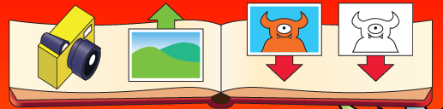

Photo Album /all of these are Phase 2/options
Touch:
Arrow:
Album
animates out
Shoot live photo:
capture live image from within camera app - save that background (persistently) to the play screen - as your new background
Get a background from Camera Roll 'library':
save that background to the play screen - as your new background
save COLOR creature to camera roll: 2 choices
-default/play background
-no background
(with logo and URL)
save coloring pages -
using outlined 'solid' black and white images
(with logo and URL)

Slide 15
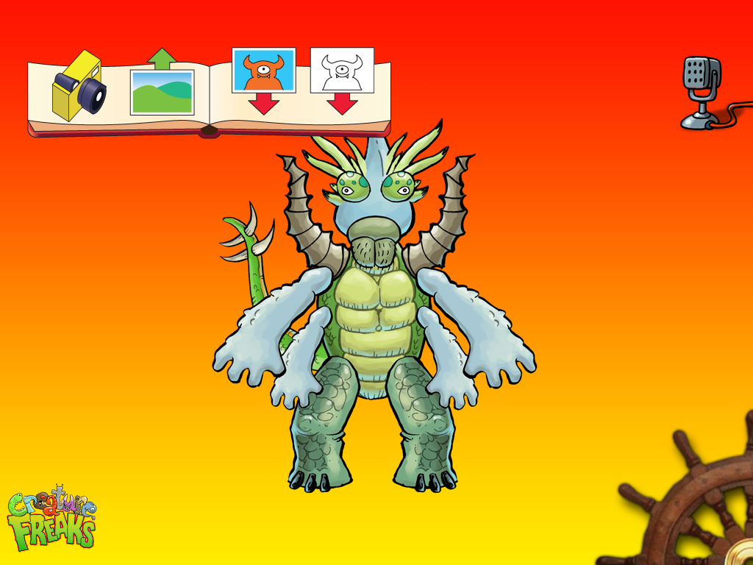
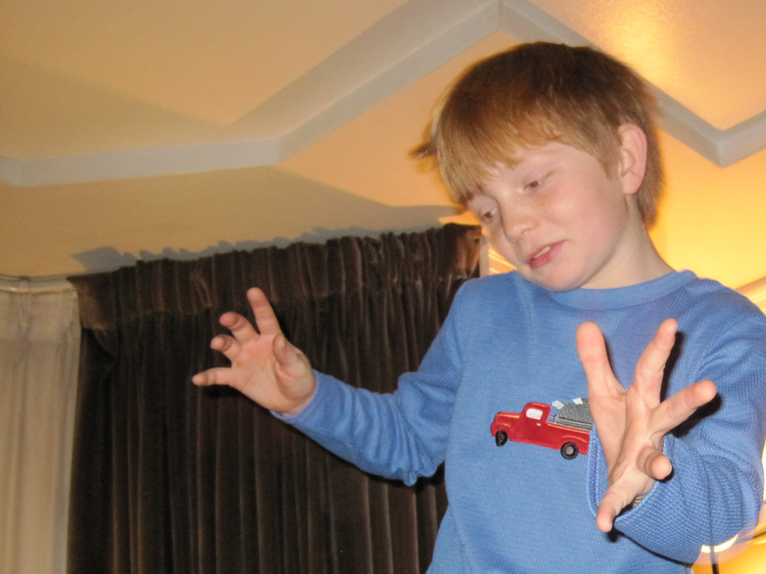
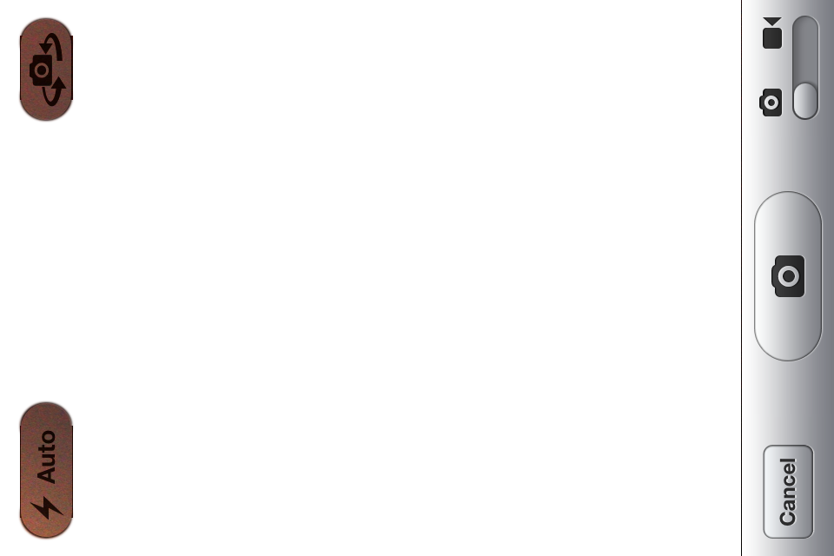

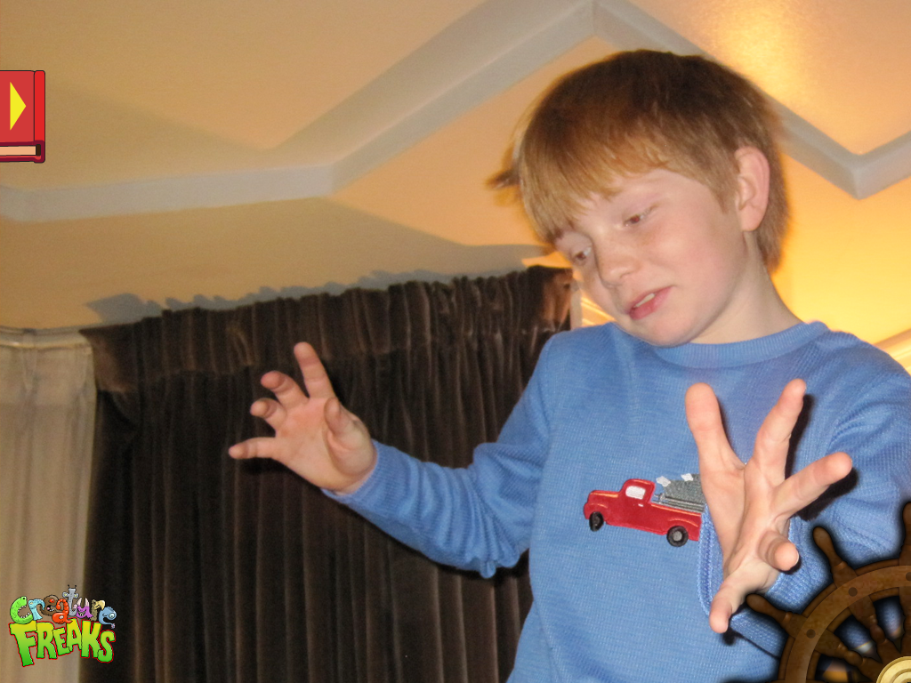
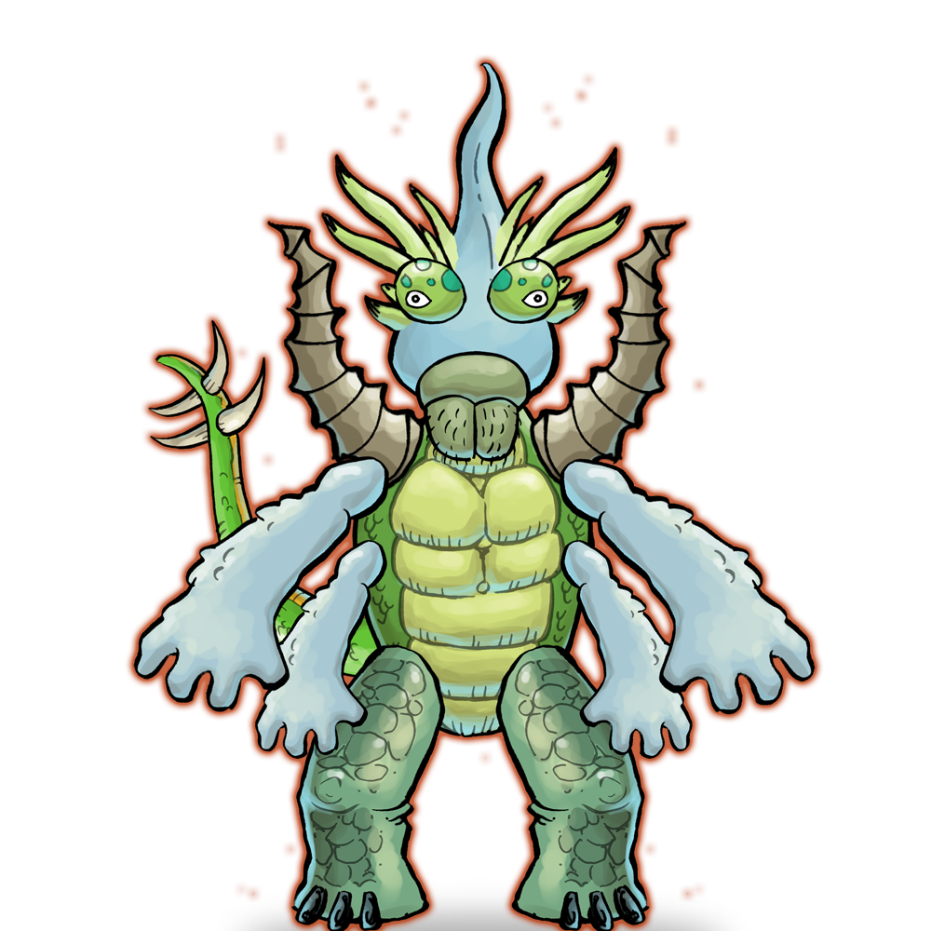

Camera IconPhase 2/options
Touch:
1-Camera icon-
Monster with Alpha (scalable) to:
Take a New Photo
-Lets you take a live picture of yourself with the monster.
Shoot live photo:
capture live image from within camera app - save that background to the play screen - as your new background
possibility of kids can resize creature on camera screen.?

Slide 16
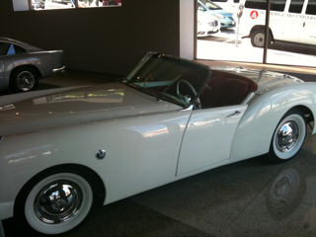
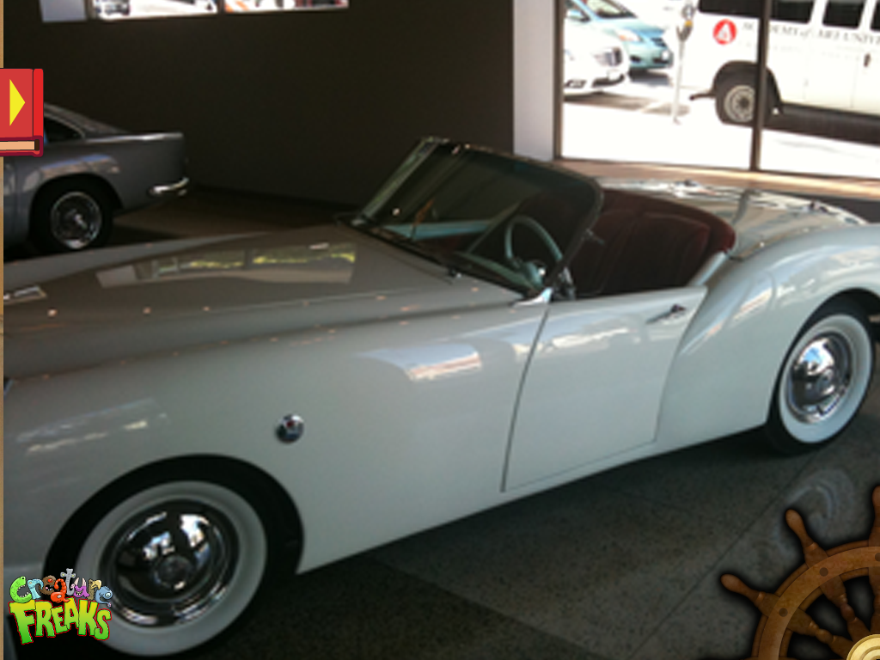
Landscape IconPhase 2/options
Touch:
1-landscape
Monster with Alpha (scalable) to:
Choose From Camera Roll
--Puts it on top of one of the images from your camera roll.

Slide 17
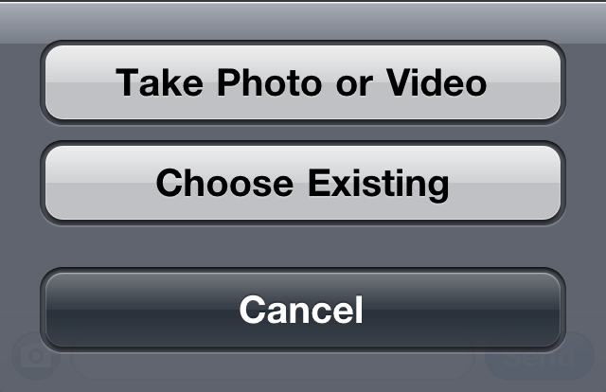
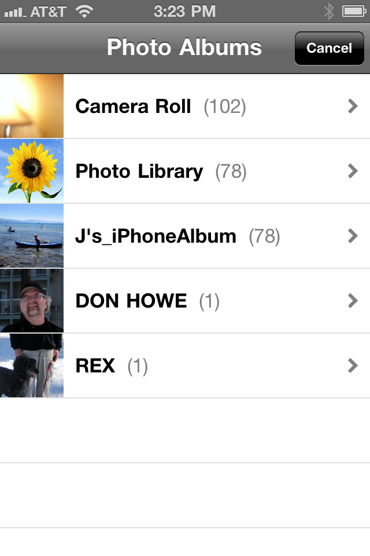
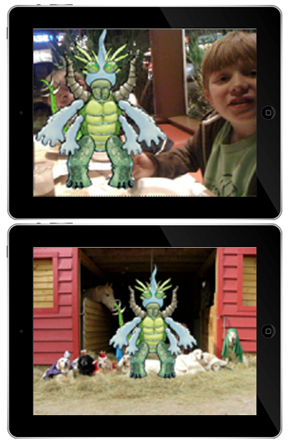
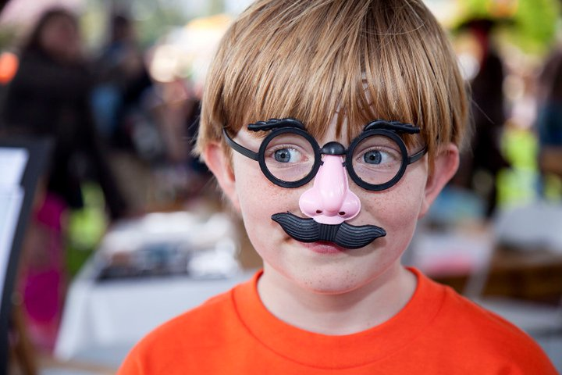
Sample Screens
for backgrounds
Phase 2/options
.
WE're splitting out a standard choice to 2 icons

Slide 18
Save Color
Phase 2/options
branded creature saved to camera roll
1- on background with www.minordistractions.com
2-on NO background
www.minordistractions.com
to be printed out & colored later from within photos / camera roll -
v2 - add email option

Slide 19
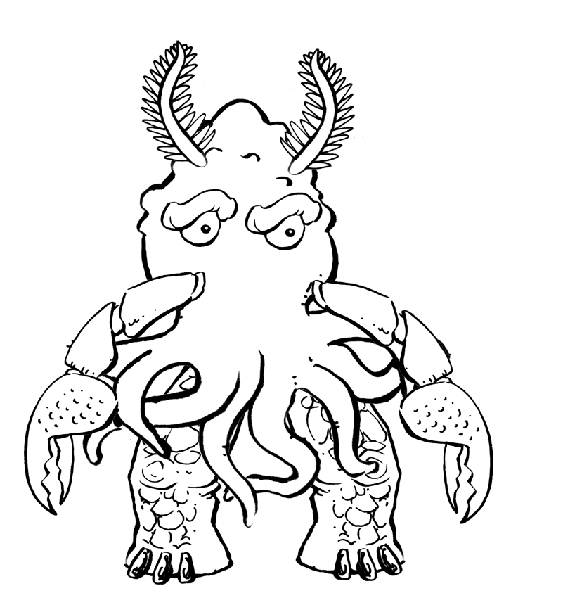

Save B&W
coloring pages
Phase 2/options
branded outlined creature
saved to camera roll to be printed out & colored in later
-?? Check mark come up to confirm that it is saved???
www.minor-distractions.com

Slide 20
In-app Purchase Overview
3 Upsells embedded in Free app:
In Edit/Create, clicking on a dimmed Body Part Type (wing/horn/tail) displays message
In Edit/Create, clicking on dimmed part displays message (i.e. we include 6 arms, but 3 are dimmed)
When they try to save add'l creatures displays message to purchase.

Slide 21
Here’s how it will hopefully work for new parts
When kids press a dimmed Body Part, this message appears:
1. Press “Buy” to purchase additional Creature Parts.
2. We will then present a “Confirm Purchase" dialog:
Confirm Your In-App Purchase.
Do you want to buy additional Creature Freaks parts?
3. Kids will then hopefully hand the phone to their parent for the password.
4. If password is valid, we’ll then display a progress dialog.
5. And finally a confirmation:
Thank You.
Your purchase was successful.

Slide 22
Future features
Share to Email, Facebook, etc.
Have "Shake" do something--maybe in on the Play screen it just bobbles about- inverse kinematics animations with sounds?
Let kids import images and put <Creature> parts on top of their own image (on both Edit & Play screen.
Manipulate Creature ON live camera
Voice Manipulation: Say something & creature repeats it
Color the coloring pages (see www.starwars.com/play/online-activities/colorbot/popup.html for example)
Make the creature into a manipulatable puzzle (see www.starwars.com/play/online-games/puzzle/ for example)

